Slide 1
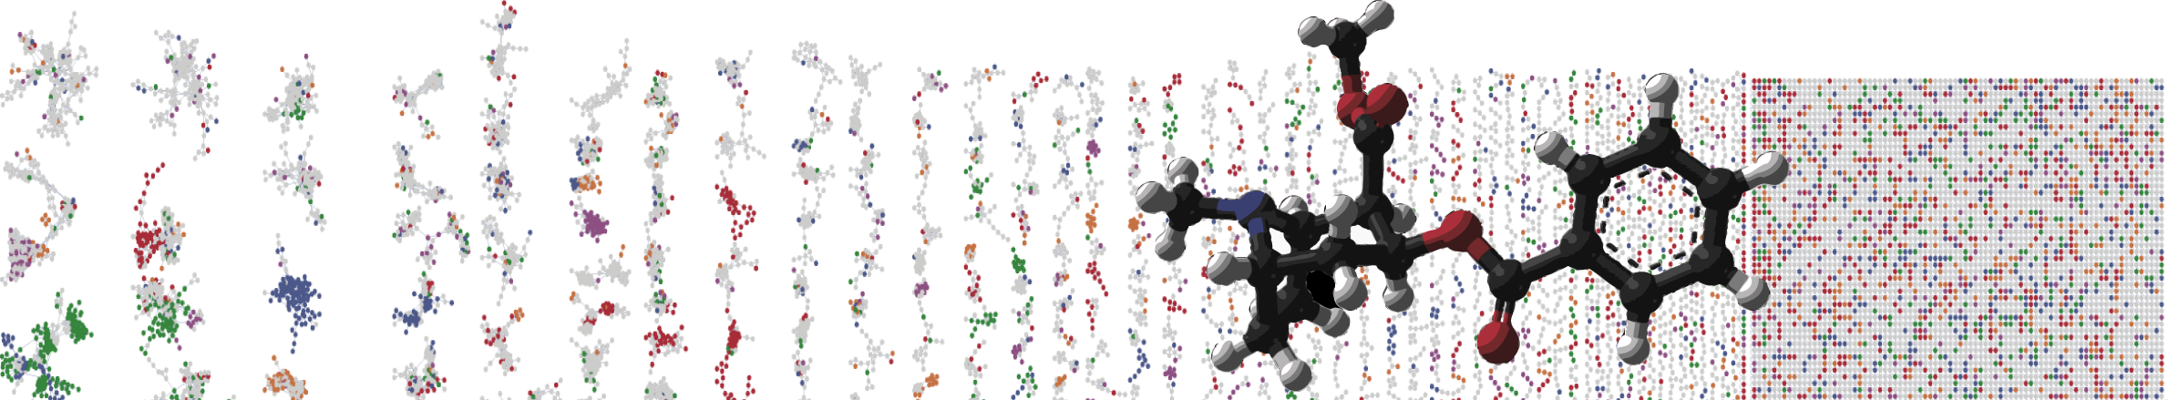


GNPS Annotating Single Spectra
ENTER AUTHORS HERE
University of California - San Diego

Slide 2
Objectives and Data
Use Workflow to Annotation Single MS/MS Spectrum
Use Classical Molecular Networking to annotate a single MS/MS spectrum
Use FBMN to annotate a single MS/MS Spectrum

Slide 3
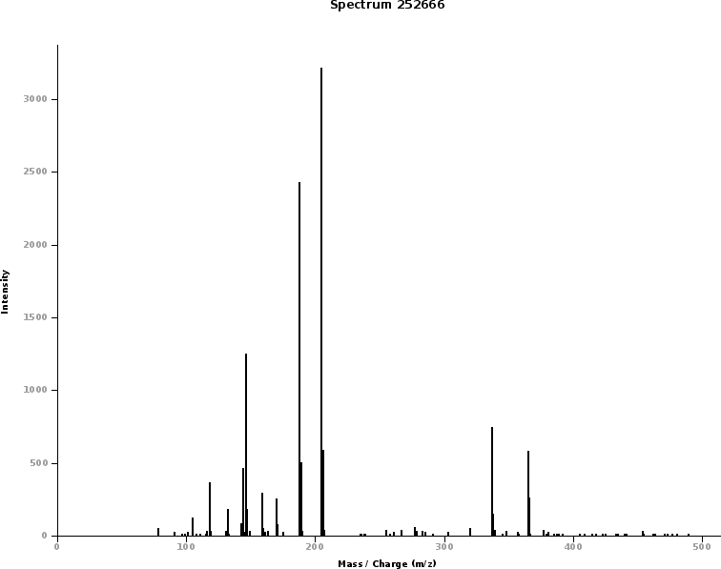
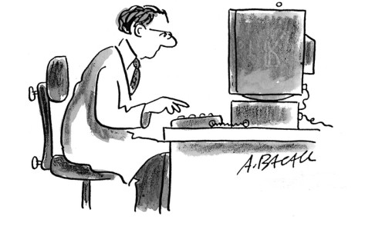
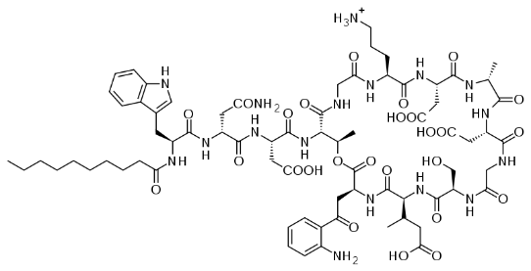
Spectral Libraries in Untargeted Mass Spectrometry
Tandem Mass Spectra
Manual Interpretation

Slide 4
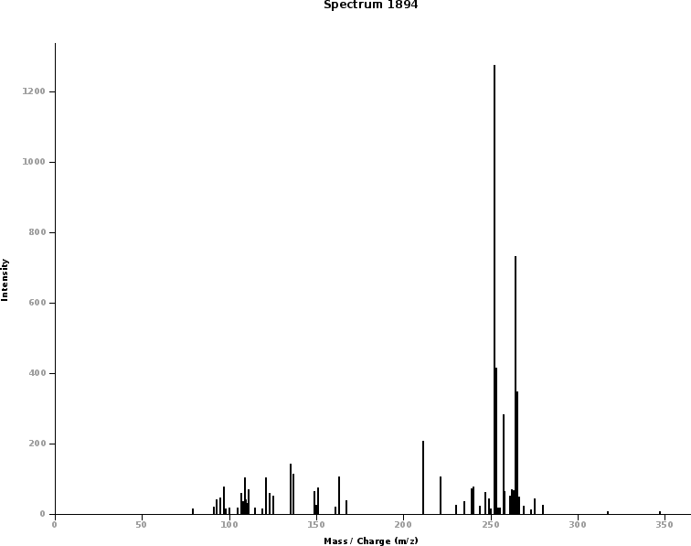
Crowd Sourcing annotations
Mass Spectra
Manual Interpretation
Spectral Library

Slide 5
Crowd Sourcing annotations
Mass Spectra
Manual Interpretation
Spectral Library
Query Spectrum

Slide 6
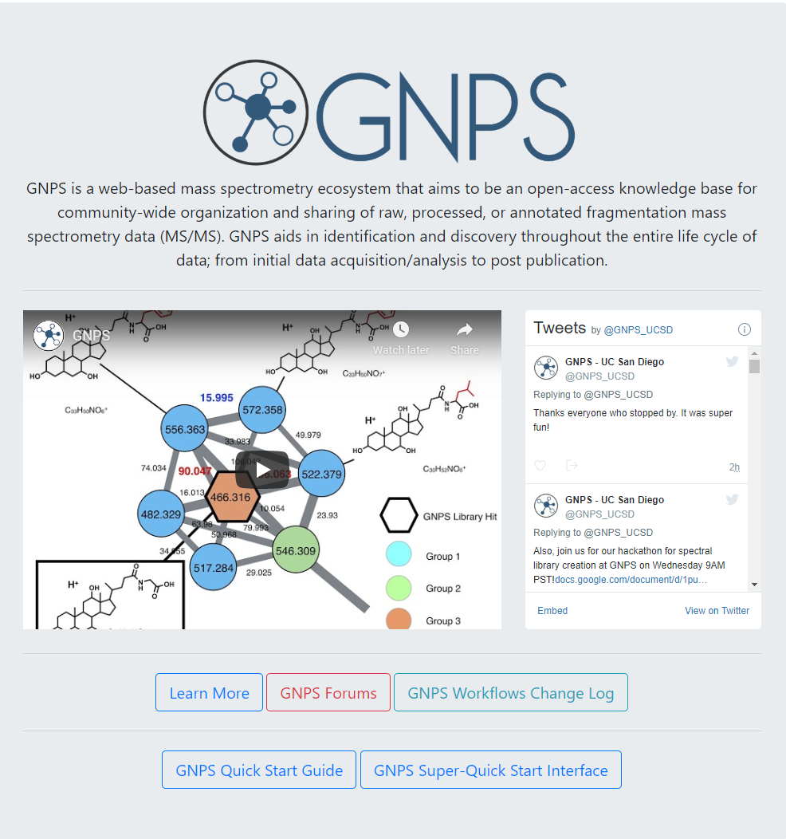
Go to GNPS (gnps.ucsd.edu)

Slide 7
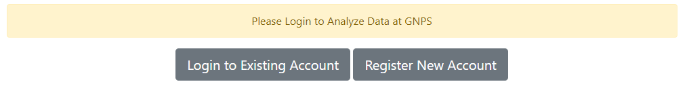

Login to GNPS

Slide 8
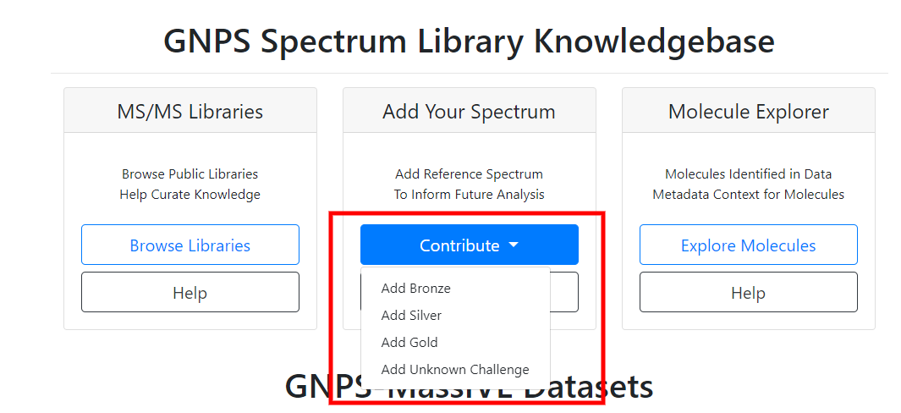
Select Add Your Spectrum

Slide 9
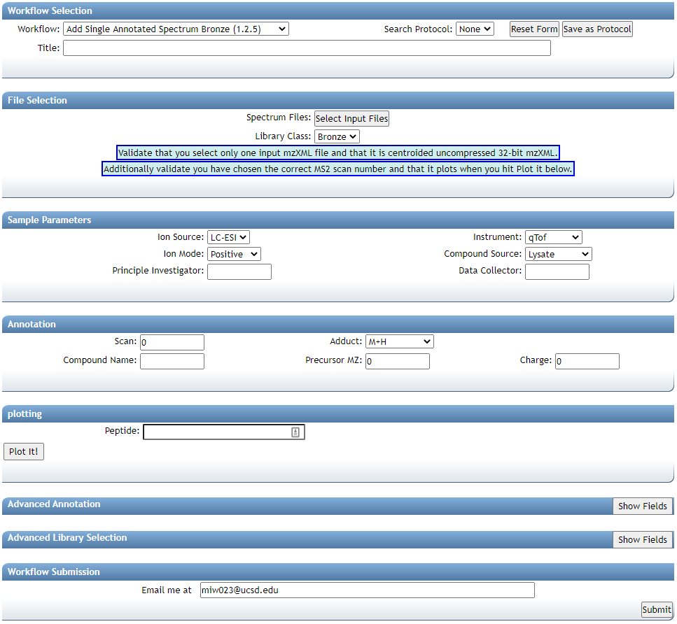
Select Input Files

Slide 10
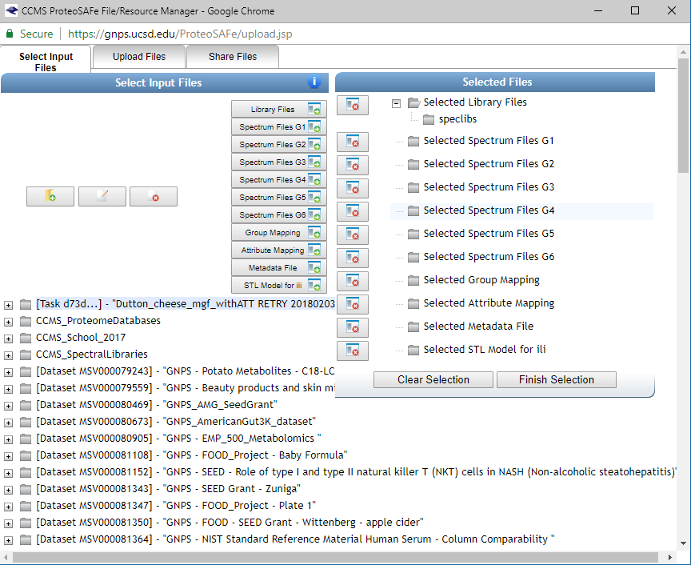
Import Public Data

Slide 11
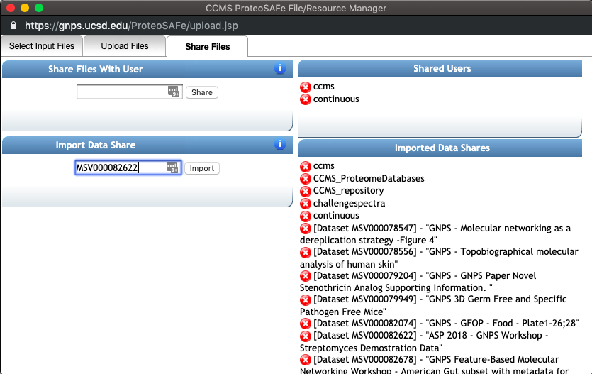
Import Public Data
MSV000082622

Slide 12
Select Data To Analyze

Slide 13
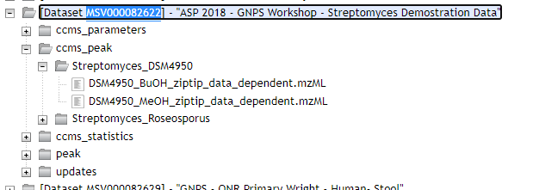
Select Test Data
1

Slide 14
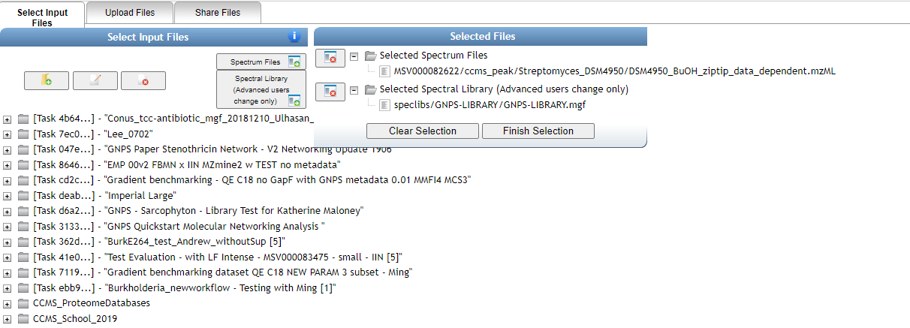
Select Test Data

Slide 15
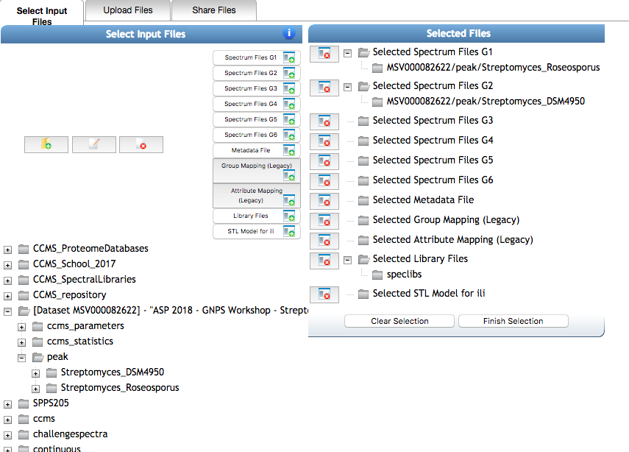
Finish Selection

Slide 16
Enter Annotation
Basic Required
Ion Source
Instrument Type
Ion Mode
Compound Source
PI
Data Collector
Scan Number in File
MS Adduct
Compound Name

Slide 17
Submit Library Spectrum
Hit Submit to add to public
GNPS Library
Don’t submit this test
as this will be public if you do!
Notes:
5-10min to see if everyone got it?

Slide 18
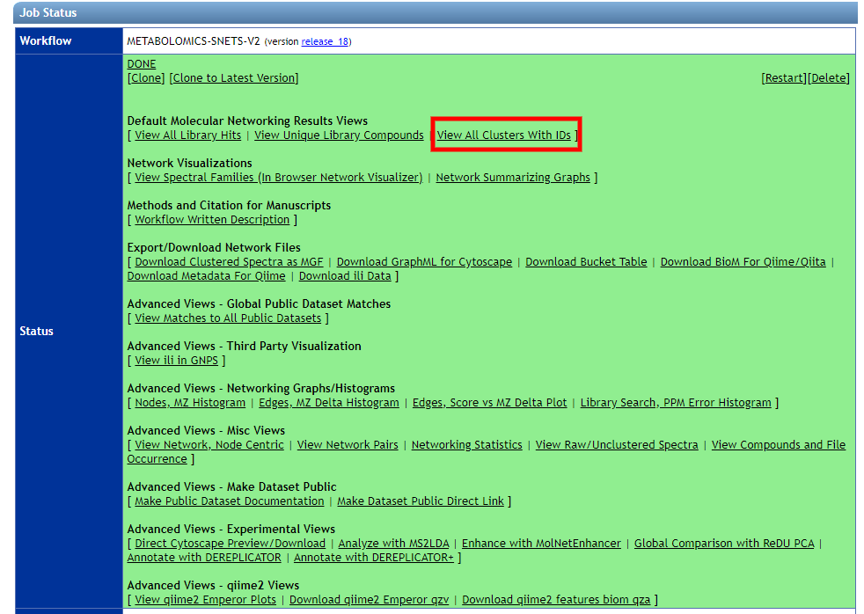
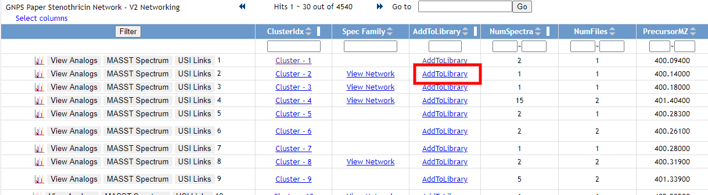
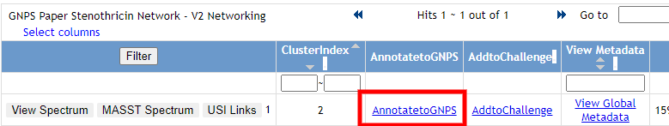
Add From Classical Molecular Networking
Select Cluster
Select Real Spectrum from List
Example Job

Slide 19
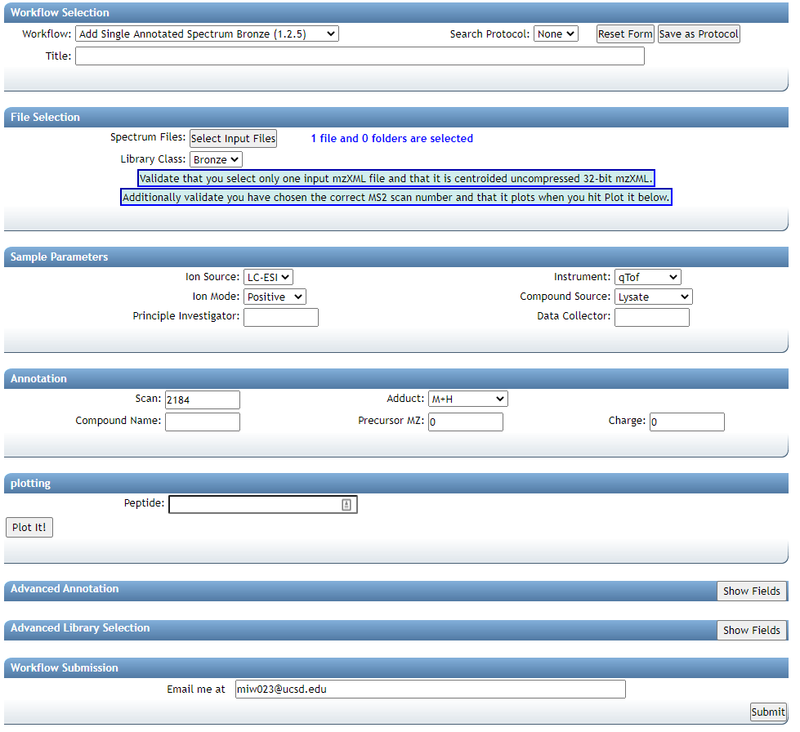
Enter Annotation
Basic Required
Ion Source
Instrument Type
Ion Mode
Compound Source
PI
Data Collector
Scan Number in File
MS Adduct
Compound Name
File and Scan Prefilled

Slide 20
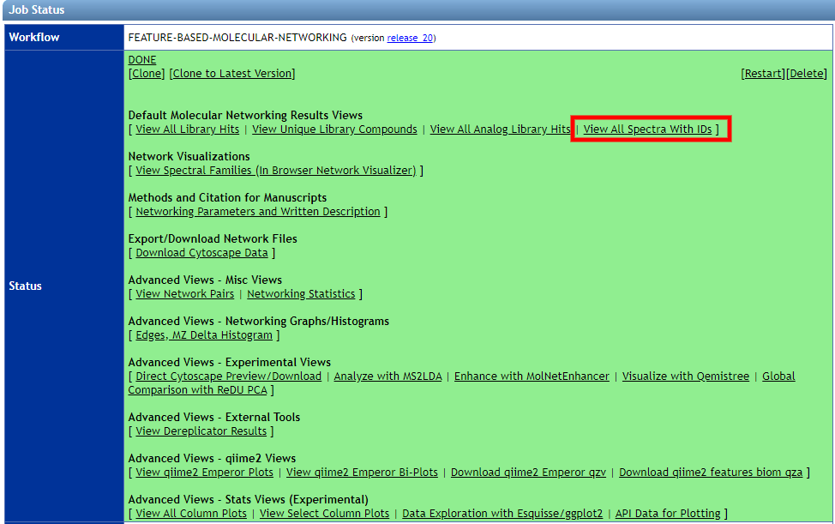
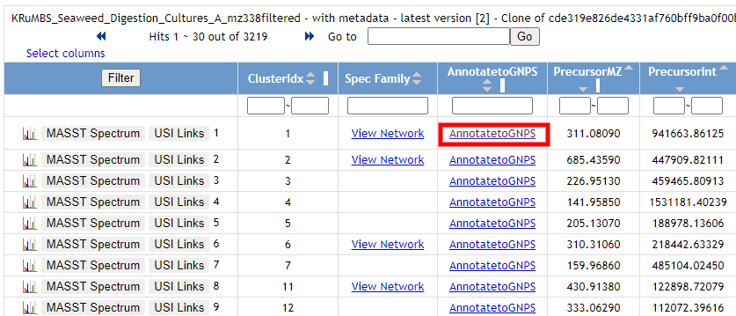
Add From Feature Based Molecular Networking
Select Cluster
Example Job

Slide 21
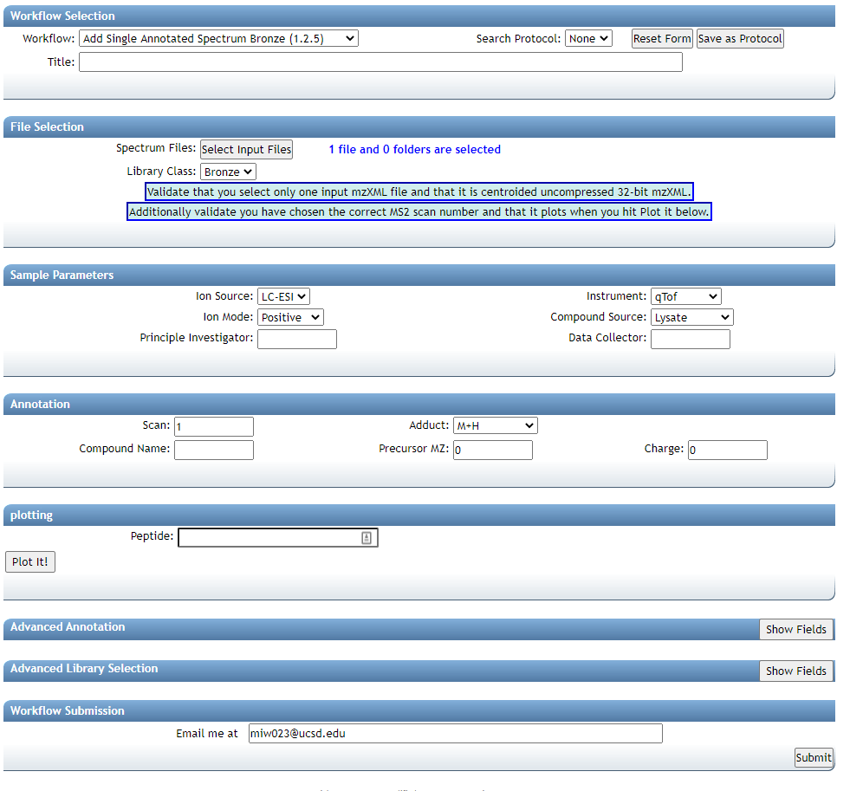
Enter Annotation
Basic Required
Ion Source
Instrument Type
Ion Mode
Compound Source
PI
Data Collector
Scan Number in File
MS Adduct
Compound Name
File and Scan Prefilled

Slide 22
Questions, Problems or Bugs?
Documentation: https://ccms-ucsd.github.io/GNPSDocumentation/
Forum: https://groups.google.com/forum/#!forum/molecular_networking_bug_reports
PRESENTER NAMES AND EMAILS HERE

